Slide 1

k-Space Deep Learning for Accelerated MRI
Mohammad Raziei

Slide 2
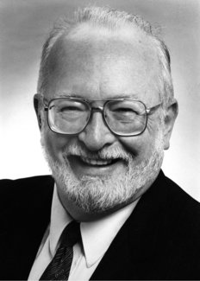
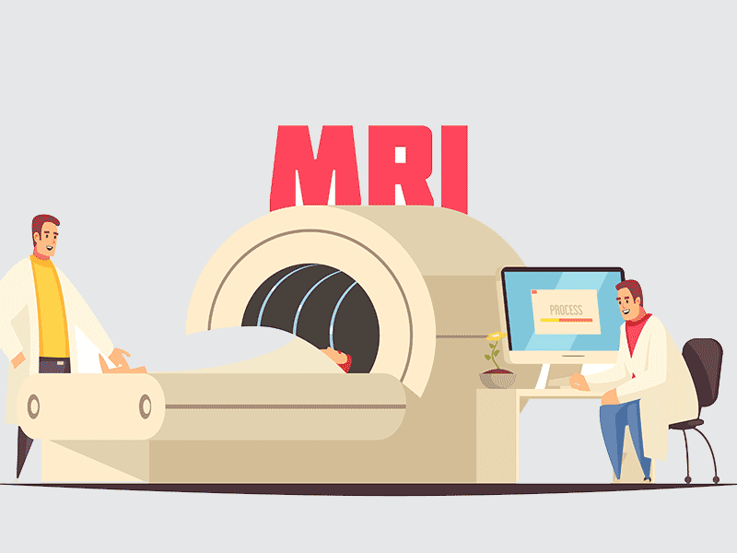
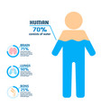
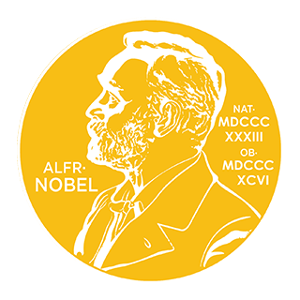
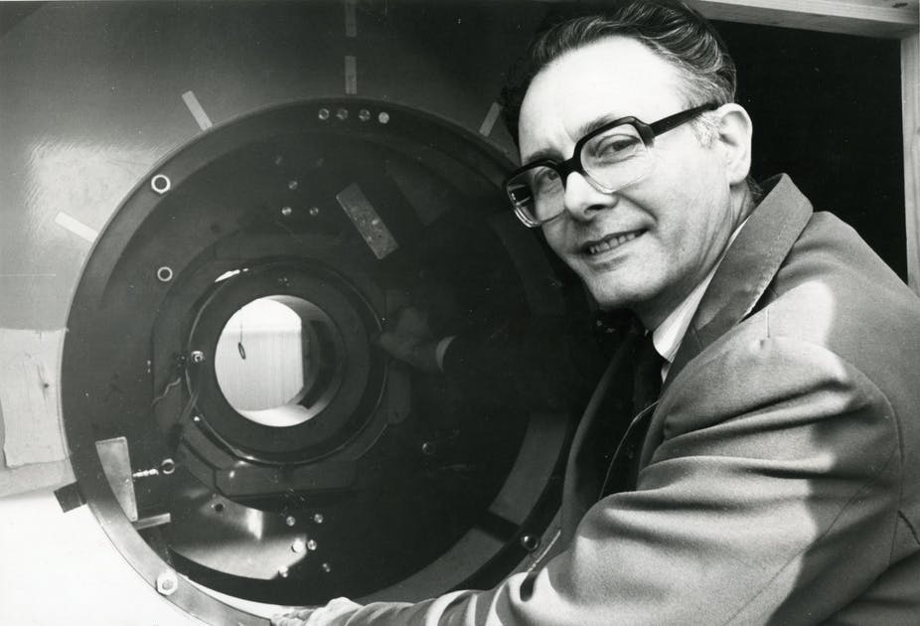
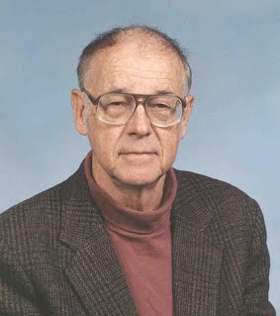
MRI Importance
Paul Lauterbur
Peter Mansfield
Herman Carr
https://www.nobelprize.org/prizes/medicine/2003/lauterbur/biographical/

Slide 3
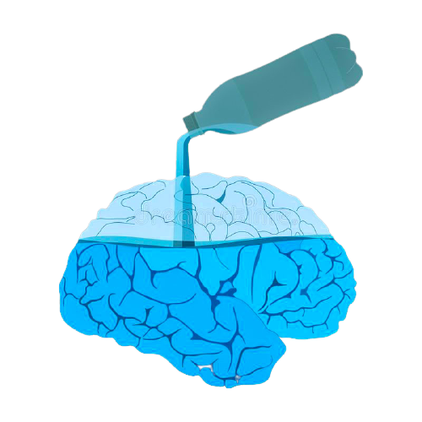
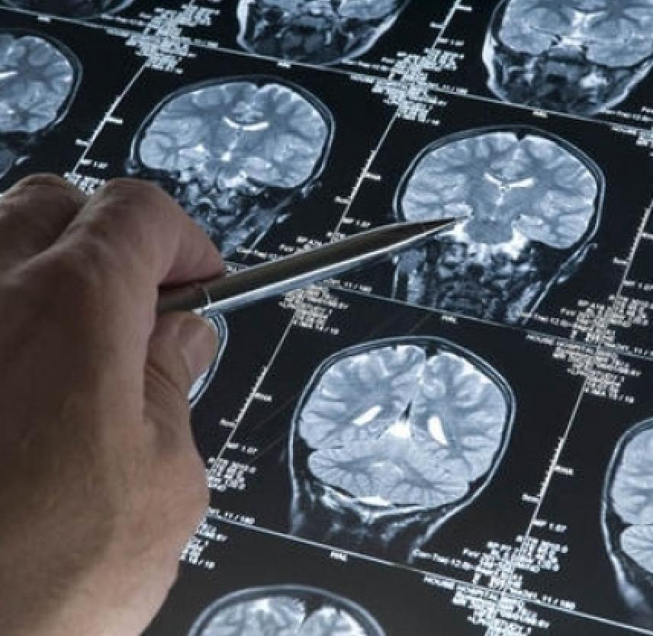
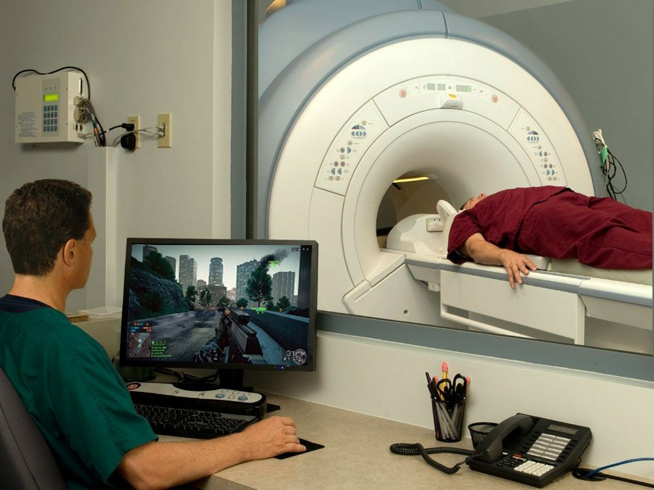
Advantages and Disadvantages
Advantages:
Imaging the hydrogen nuclear
Be able to capture soft tissues
Invasive method
Disadvantages:
Too slow! (why?????)
Data acquisition need time.
So why again?

Slide 4
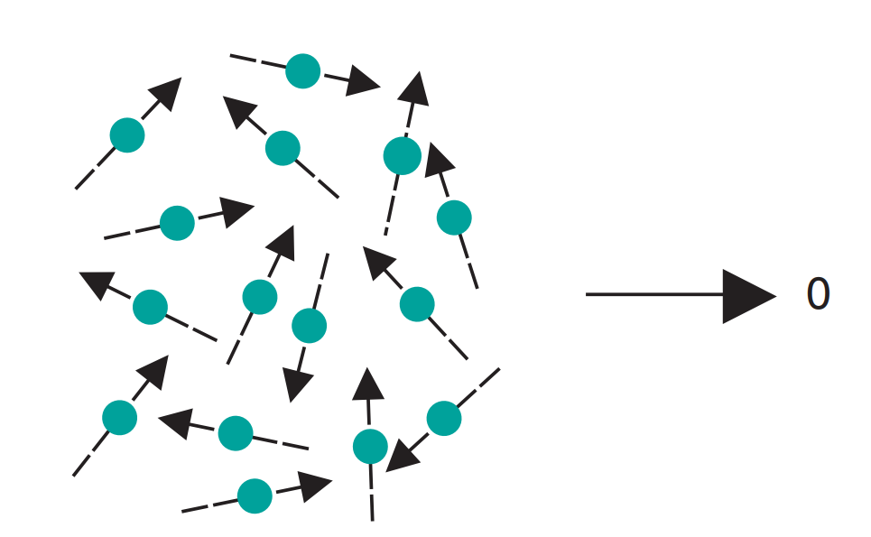
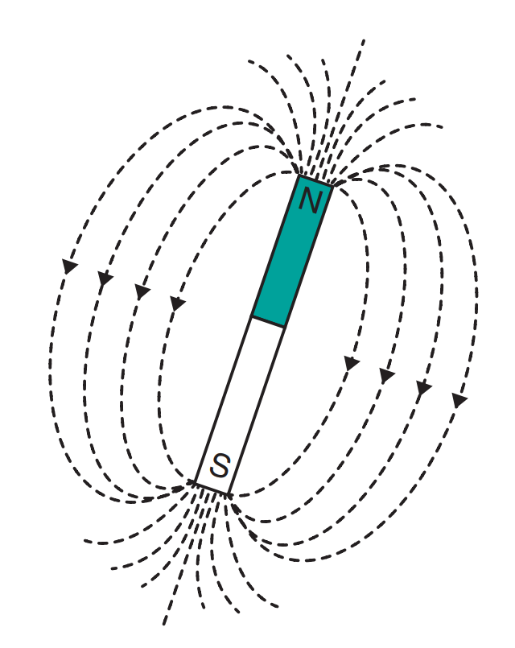
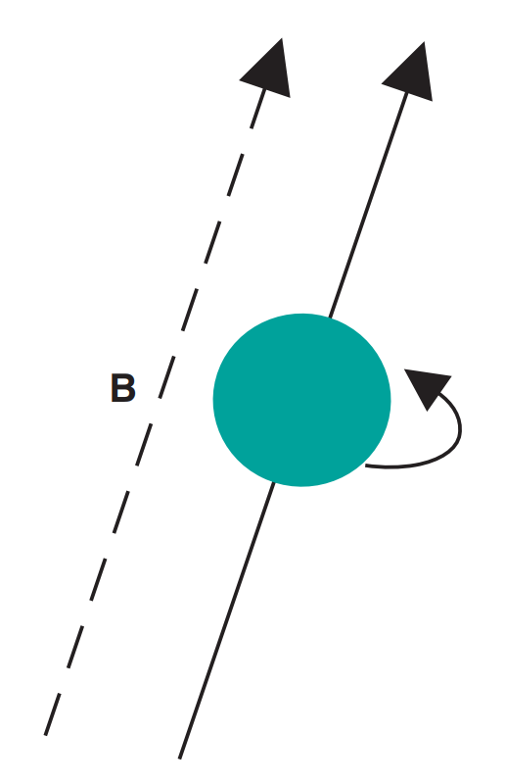
MRI basics

Slide 5
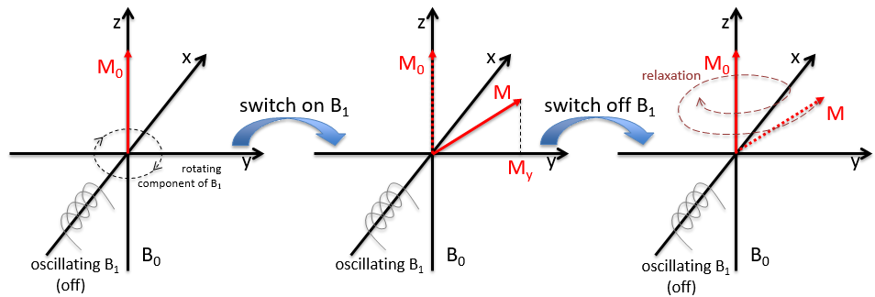
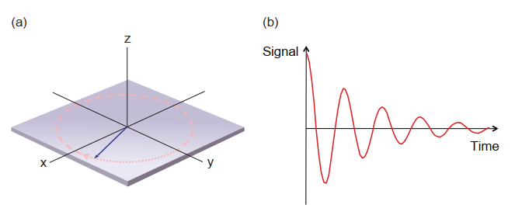
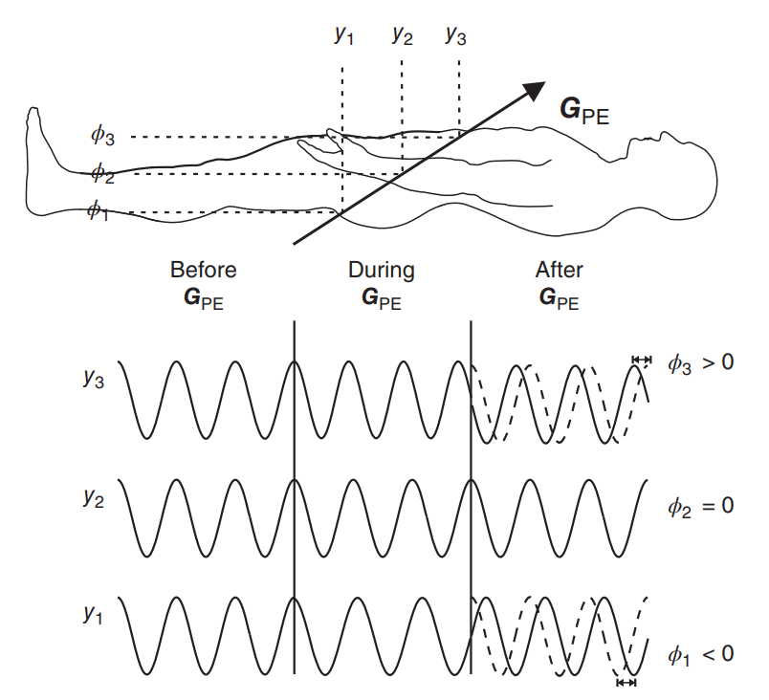
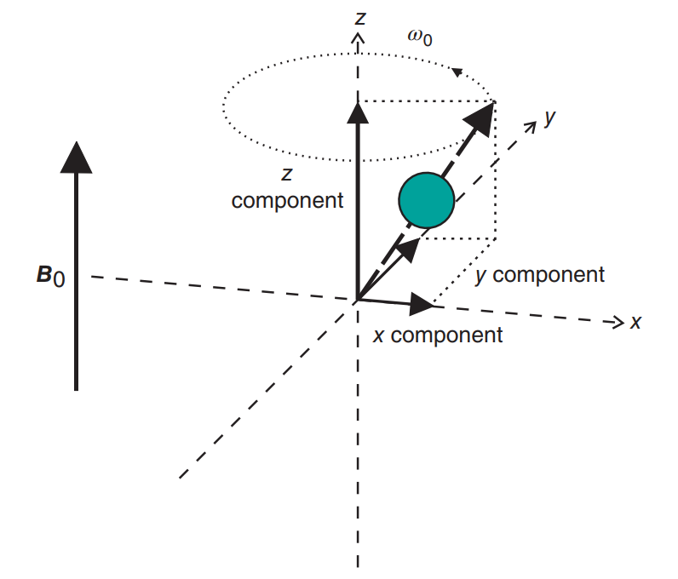
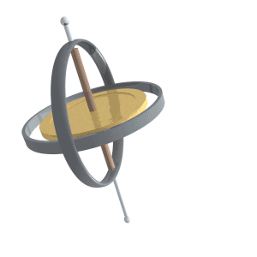
MRI basics

Slide 6
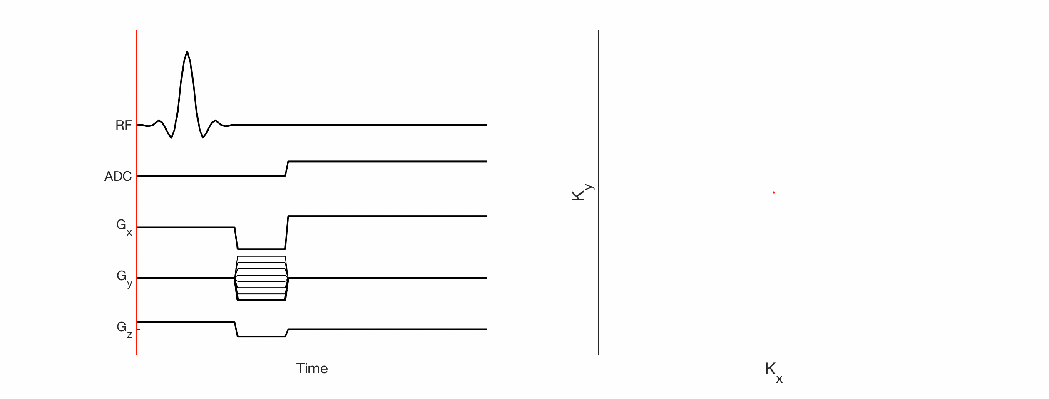
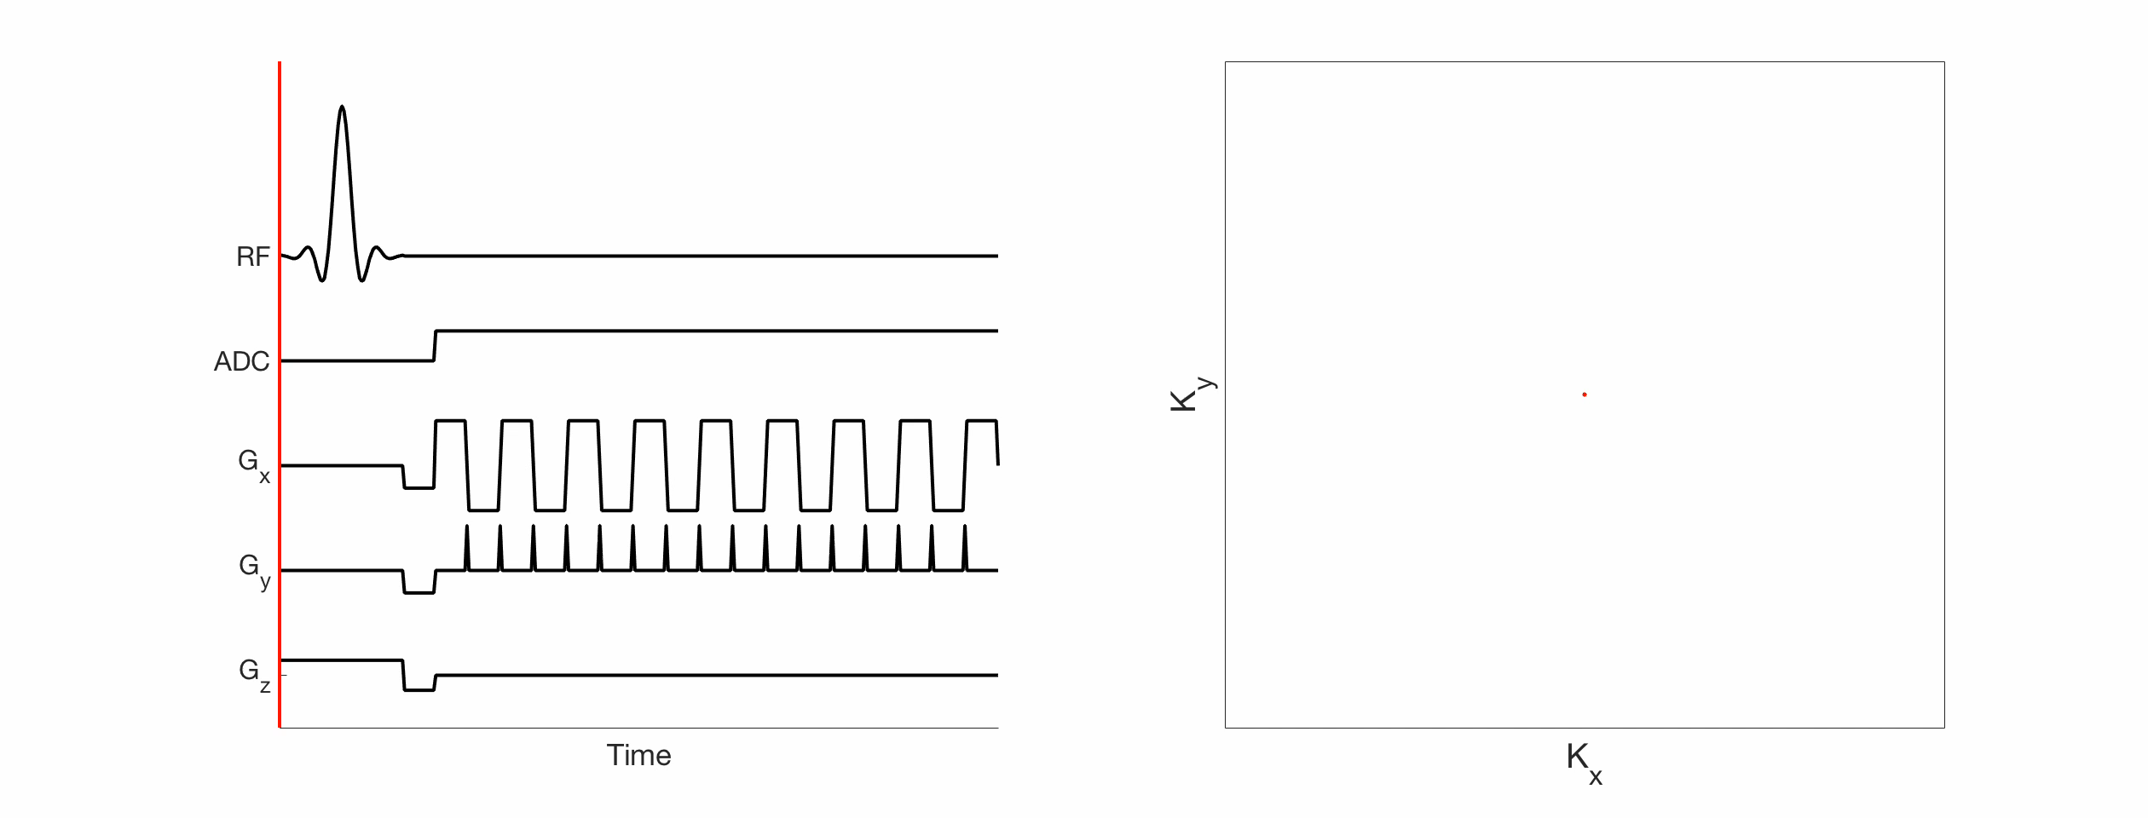
Filling the k-space
echo planar imaging (EPI)

Slide 7
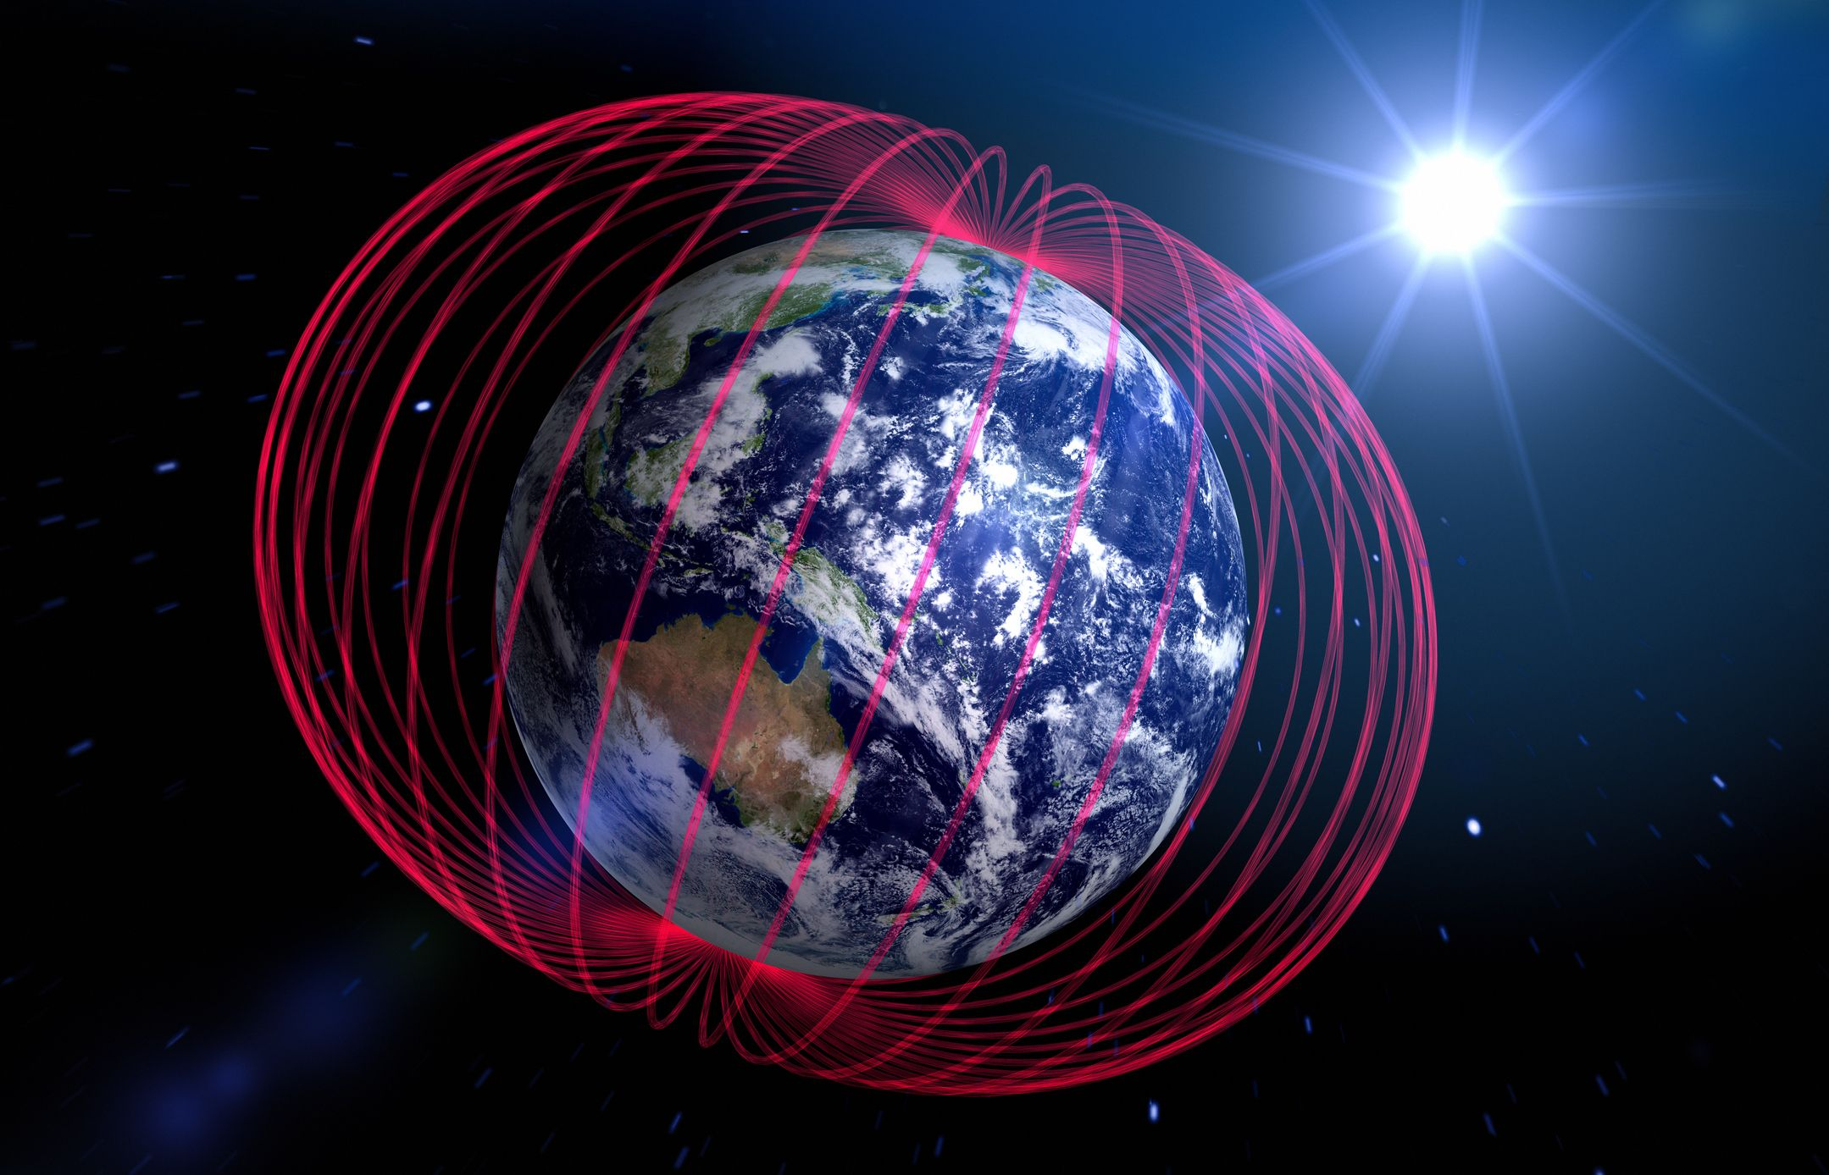
How To make MRI fast?
Increase Magnetic (B)
Usually: 0.2 T, 1 T, 1.5 T, 3 T
7 T, 9 T
Earth’s magnetic field: 25 to 65 μT (0.25 to 0.65 gauss)
Decrease sampling rate (!)
CS-MRI
P-MRI
Deep-Learning
ALOHA

Slide 8
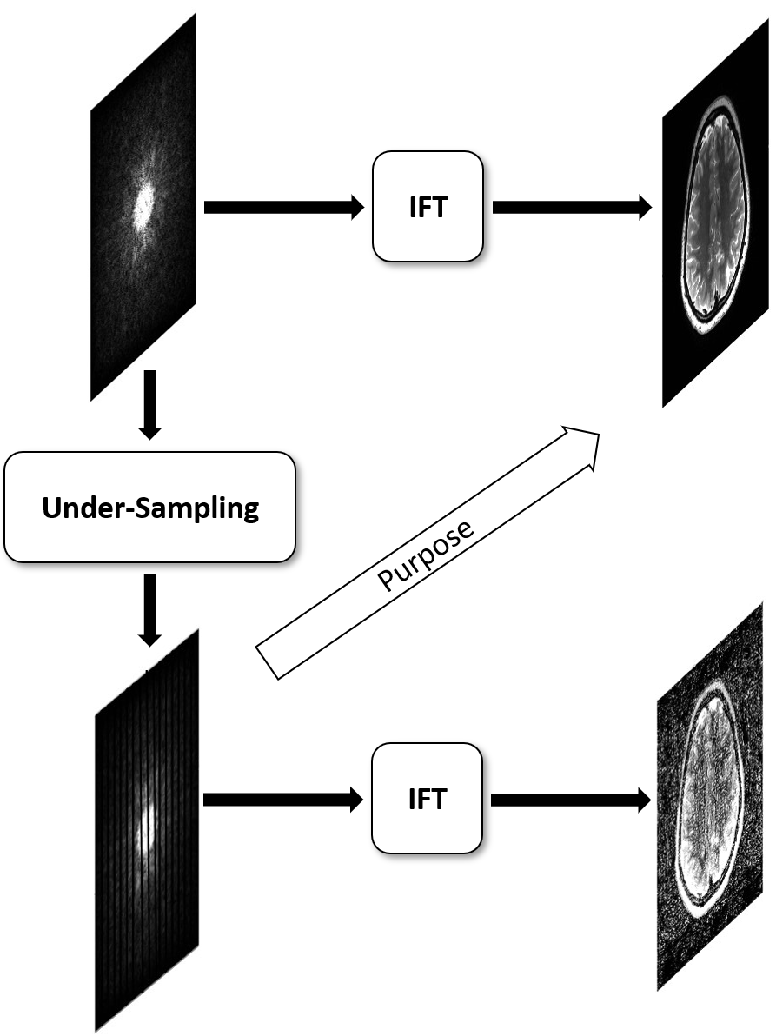
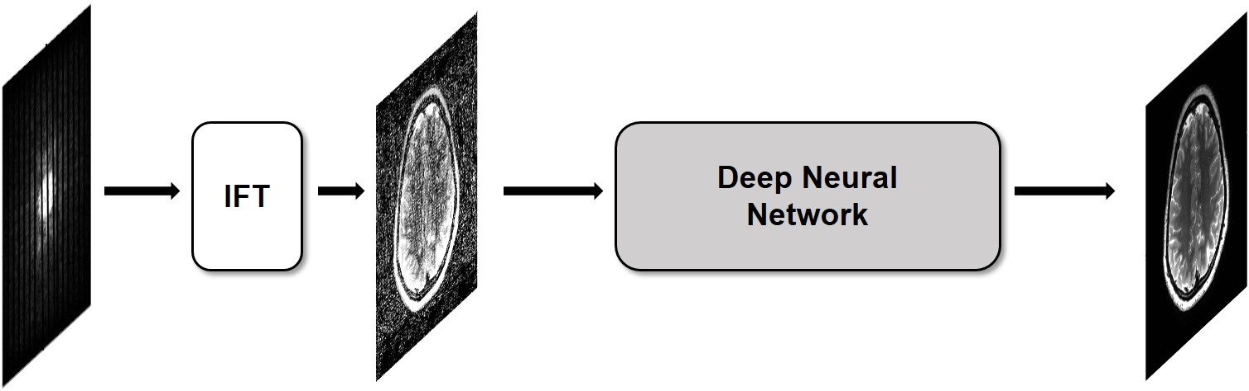
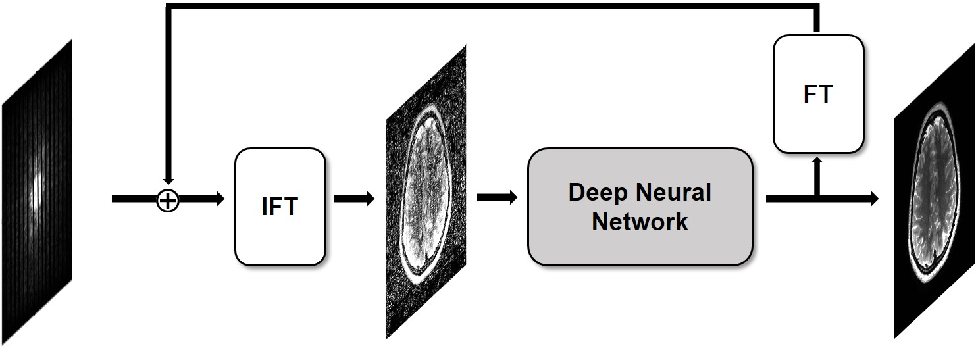
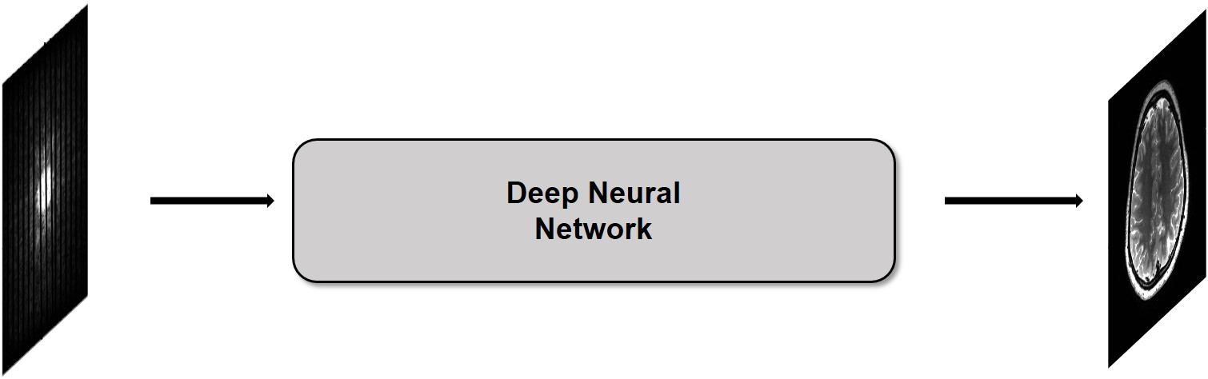
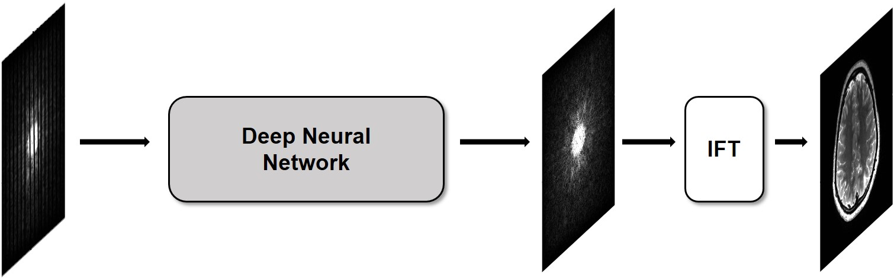
Decrease sampling rate

Slide 9
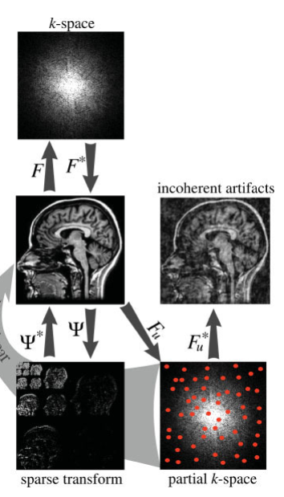
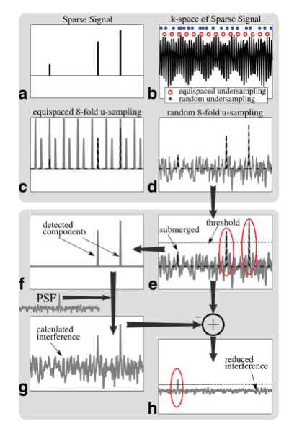
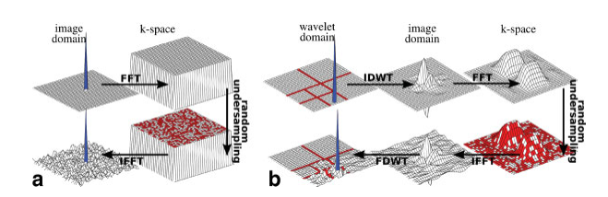
Decrease sampling rate

Slide 10
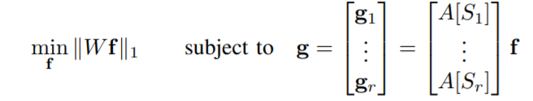
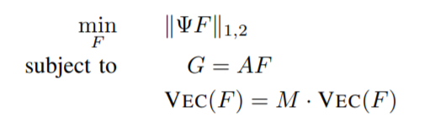
Compressive Sampling using Annihilating Filter-based Low-Rank Interpolation (ALOHA)
https://ieeexplore.ieee.org/abstract/document/7744614

Slide 11
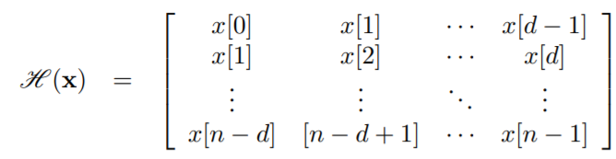
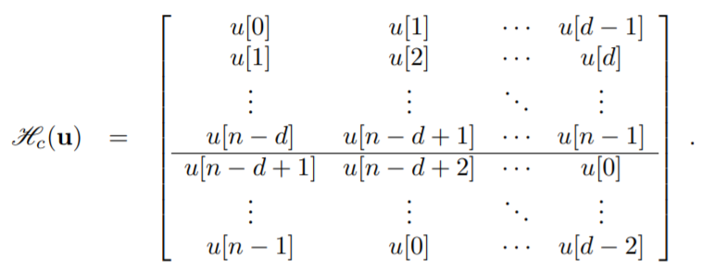
ALOHA

Slide 12
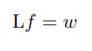
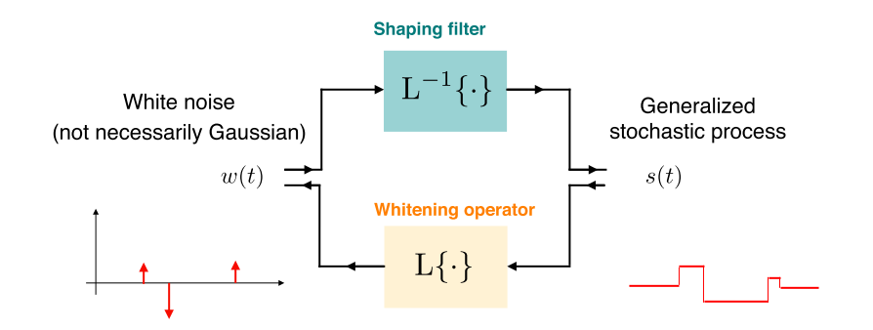
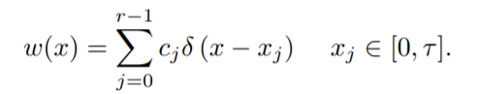
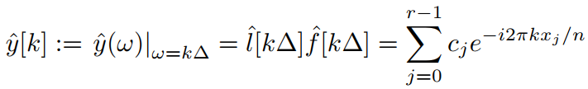
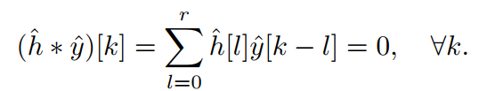

Slide 13
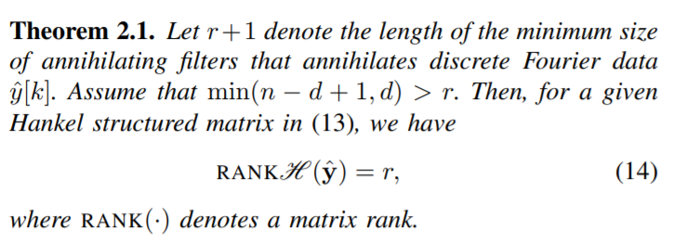
ALOHA

Slide 14
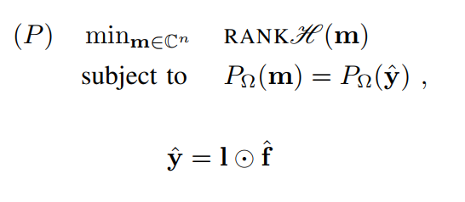
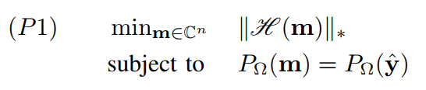
ALOHA

Slide 15
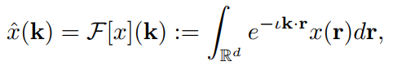
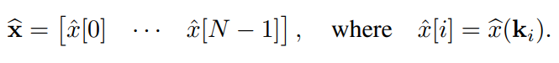
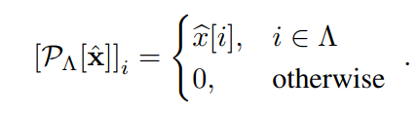
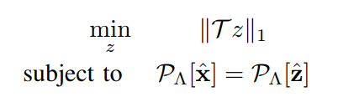
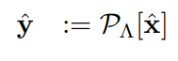
Deep learning
duality between the structured low-rankness in the k-space and the image domain sparsity

Slide 16
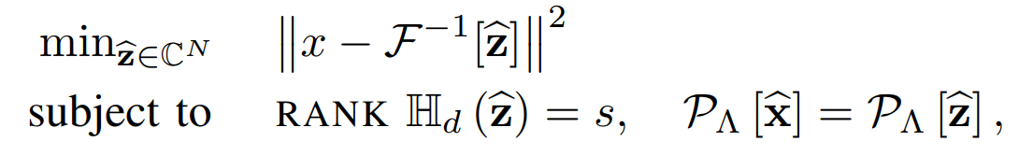
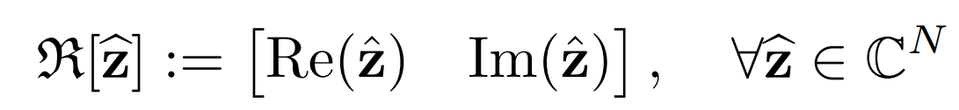
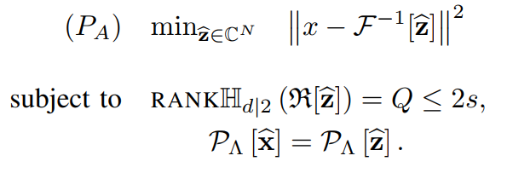
Deep learning

Slide 17
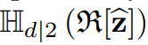
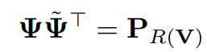






Deep learning
low-rank projection constraint
=
Pooling and unpooling

Slide 18


Architecture

Slide 19




Performance Evaluation

Slide 20

Results

Slide 21
References
k -Space Deep Learning for Accelerated MRI
https://ieeexplore.ieee.org/document/8756028/
Robust Spectral Compressed Sensing via Structured Matrix Completion
https://ieeexplore.ieee.org/document/6867345
Exact low-rank matrix completion via convex optimization
https://ieeexplore.ieee.org/abstract/document/4797640/
Matrix completion from a few entries
https://ieeexplore.ieee.org/document/5205567
Compressive Sampling using Annihilating Filter-based Low-Rank Interpolation
https://ieeexplore.ieee.org/abstract/document/7744614

Slide 22
The END

